Slide 1
Sleep Journal Club
Sept 3 2022

Slide 2
Goals:
Understand that the disjunctive syllogism is the structure of a scientific argument
Know the limitations of a cross-sectional design as compared to cohort as compared to randomized trial viz-a-viz causal inference
Understand what a hazard ratio is and why they are so common in medical research
Know the determinants of a studies power.

Slide 3
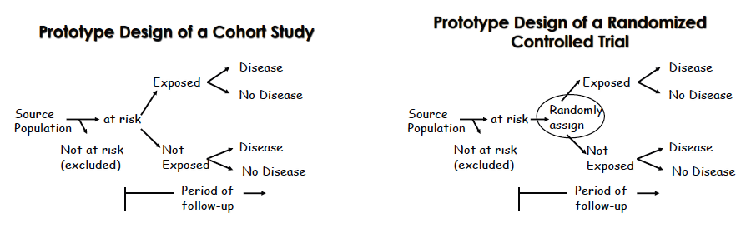
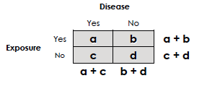
Imagine it’s 1950. You discover that OSA is very common. How do you figure out if it matters?

Slide 4
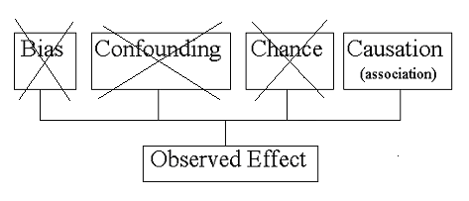
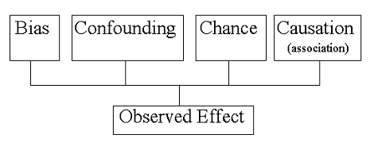
Structure of Observational Study ‘Argument’: Disjunctive Syllogism
Notes:
Greg Stoddard Biostats Manual

Slide 5
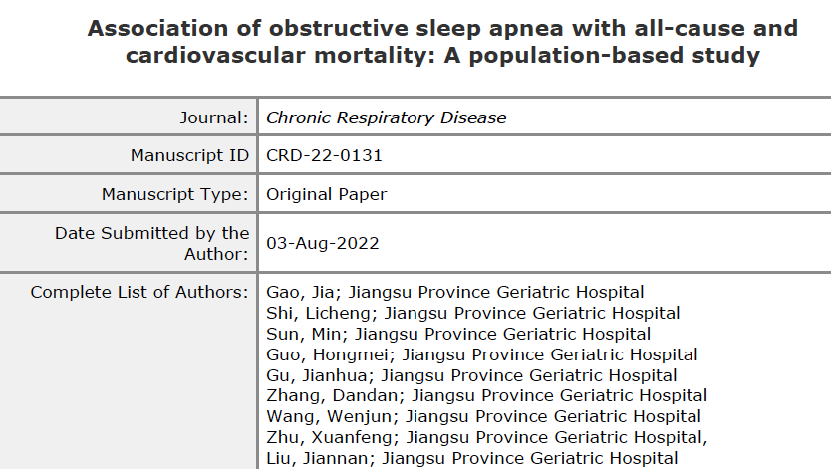

Slide 6
Association of obstructive sleep apnea with all-cause and cardiovascular mortality: A population-based study
Design: Retrospective Cohort
Population: NHANES (multistage-sampling survey) 2005-8 who had OSA status and CV status known (9000 pt)
  Exposed: Yes to ”Have you been told you have a sleep problem: OSA”
  Unexposed: no to the above
Outcome: Prevalent HTN, CV disease; Incident CV-death and mortality
Statistics: Logistic (yes/no) and Cox (Hazard Ratio) regressions accounting for demographics, health status.
Findings: Prevalent HTN+CV indep assoc, CV-death and mort not

Slide 7
Statistical Teaching point:
Ascertainment of exposure status
  Is “Have you ever been diagnosed with OSA?” accurate?
  How would you expect the group assignment to change if PSG was used?
    If you could design a perfect categorization of the groups, what would it be?
  How would this effect the study conclusions?
Notes:
Many – if not majority – not diagnosed
True if survey or PSG used - Need screening on everyone to accurately classify
Two groups are more similar to each-other than not

Slide 8
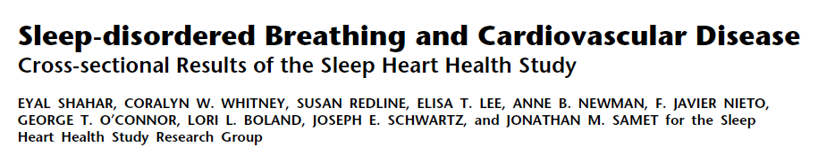

Slide 9
Sleep-disordered Breathing and Cardiovascular Disease
Cross-sectional Results of the Sleep Heart Health Study
Design: Retrospective Cohort Cross-sectional
Population: Sleep Heart Health (1995-98), n=6424 (-1200 missing data)
  Exposed/Unexposed: AHI quartile (0-1.3, 1.4-4.4, 4.5-11.0, 11+)
    Also, Sleep hypoxemia and arousal index
Outcome: Prevalent odds of CVD (why not incident?)
Statistics: Logistic regression with possible confounders
Findings: Quartile III and IV of AHI and %Hypoxemia indepdently associated with prevalent CVD (particularly HF and Stroke).
Notes:
Representative cohort
All had home sleep studies (with addition of some EEG by the sounds of it.
Interviewed patients about previously diagnosed conditions

Slide 10
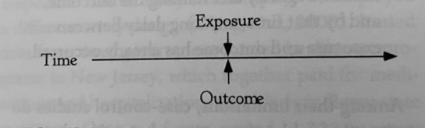
Cross-sectional vs Retrospective Cohort
Cross-sectional study: exposure and outcome assess simultaneously
  Cohort study: exposure assessed before outcome
Can only investigate prevalence of disease
  Pros: easy, reliable if exposure doesn’t change (eg genetics), or prior exposure hard to remember (eg diet)
  Cons: can’t determine direction of causality, current exposure=surrogate for past exposure, overrepresent longer duration cases.

Slide 11
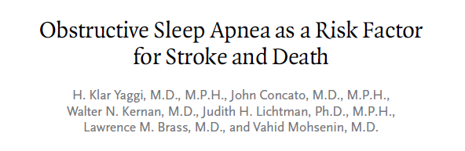

Slide 12
Obstructive Sleep Apnea as a Risk Factor for Stroke and Death
Design: Prospective cohort (clinical)
Population: W/o pre-existing CVD referred for SDB eval @ Yale. 1997-2000, n=1022
  Exposed: Referred to clinic, AHI > 5 events/hr
  Unexposed: Referred to clinic, AHI < 5 events/hr
Outcome: incident stroke or death, median follow-up 3.4 yr
Statistics: Cox-regression~=Kaplan Meier/Log rank/proportional hazard
Findings: OSA associated with HR 1.97 for stroke or death after adjusting for confounders

Slide 13
Community vs Clinical Cohort
Population of interest
Community comparison:
  (C+D) vs A
Clinical comparison:
  C vs B
Any factor that changes the likelihood of B+C is a potential confounder
  If, rather than population burden, you are interested in how to care for B+C, this may be the correct method
Seeks care
A
B
Has OSA
C
D

Slide 14
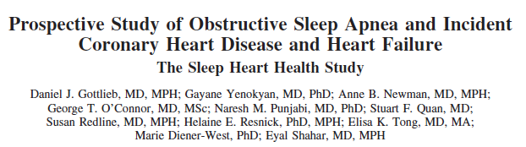

Slide 15
Prospective Study of Obstructive Sleep Apnea and Incident Coronary Heart Disease and Heart Failure
The Sleep Heart Health Study
Design: Prospective cohort (community)
Population: Sleep Heart Health (1995-98), n=6441 (-2000 excluded))
  Exposed: Mild (5-15), Moderate(15-30), Severe (30+) OSA by AHI. Mostly untreated (2.1% overall, 8.4% w mod-sev OSA treated)
  Unexposed: AHI < 5 events/hr
Outcome: incident CHD before 4/1/06 (~8.7y)
Statistics: Cox-regression (HR)
Findings: More severe OSA independently associate with incident CHD (particularly CHF) in men, not women.
Notes:
Models are presented that adjusted
for the following: (1) Age, race, BMI, and smoking status (with
indicator variables for current and former smoking); (2) these
variables plus total and HDL cholesterol and diabetes mellitus,
which are causes of cardiovascular disease for which the causal
relation to OSA is uncertain; and (3) these variables plus hypertension hypertension
(systolic blood pressure, diastolic blood pressure, and use of
antihypertensive medications), which has been hypothesized to lie on
the causal pathway between OSA and cardiovascular disease

Slide 16
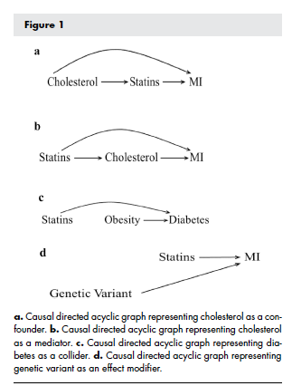
Confounders, Regressions
Regression: estimate effect with “all other things held equal”.
  How do you decide what things to include?
    Confounders
    Mediators?
    Colliders?
  Is your understanding of what factors matter correct?
  Can you measure everything you want to measure?

Slide 17
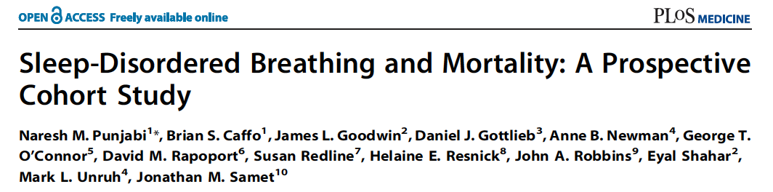

Slide 18
Sleep-Disordered Breathing and Mortality: A Prospective Cohort Study
Design: Prospective cohort (community)
Population: Sleep Heart Health (1995-98), n=6441 (-147 excluded d/t OSA treatment)
  Exposed: Mild (5-15), Moderate(15-30), Severe (30+) OSA by AHI. Mostly untreated (2.1% overall, 8.4% w mod-sev OSA treated)
  Unexposed: AHI < 5 events/hr
Outcome: (incident) death w/ ~8.2y avg follow-up
Statistics: Cox-regression (HR)
Findings: Mod-severe OSA (men) and severe OSA (women) associated with increased hazard of mortality. No relationship if age 70+
Notes:
“Briefly,
between 1995 and 1998 participants were recruited from
prospective cohort studies including the Framingham Offspring
and Omni Study, the Atherosclerosis Risk in Communities Study,
the Cardiovascular Health Study, the Strong Heart Study, and the
cohort studies of respiratory disease in Tucson and of hypertension
in New York. Eligible individuals were at least 40 years of age and
were not being treated for sleep-disordered breathing with positive
airway pressure, oral appliance, oxygen, or tracheostomy
”

Slide 19
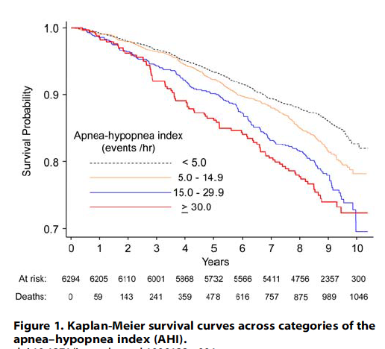
What is a Hazard Ratio / KM / Cox-regression?
We’re all dead in the long run
2 versions of Russian Roulette
  X: 1:6 w/ bullet, Y: 1:4 w/ bullet
    HR = (1/6) / (1/4) = 0.67
  1000 people play 11 rounds of each
  On round
  P(Surviving 10 rounds?)
    X: (5/6)^10 = 16% -> 160 survivors
    Y: (3/4)^10 = 5.6% -> 56 survivors
      RR would be 84% / 94.6% = 0.88
  Round 11: X = 27 die, Y = 14 die yet HR higher in group Y!
  What if Group Y says screw it after 7 rounds, but we want to maximize our data?
    HR allows for “censoring of data”

Slide 20
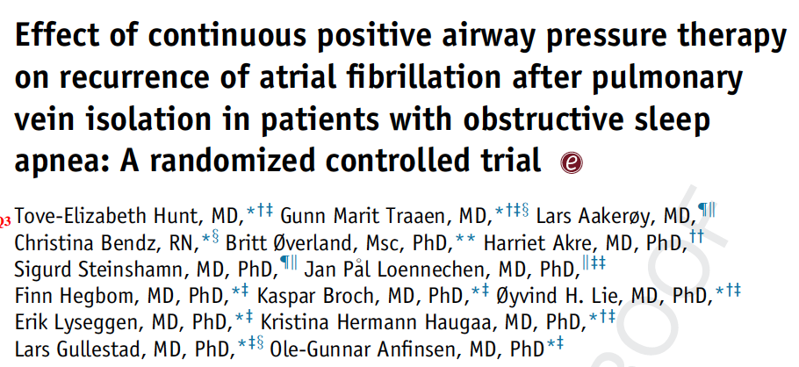

Slide 21
Effect of continuous positive airway pressure therapy on recurrence of atrial fibrillation after pulmonary vein isolation in patients with obstructive sleep apnea: A randomized controlled trial
Design: Open-label RCT (A3 study, Oslo)
Population: new dx AHI 15+, ESS < 15 (etc), undergoing CA-PVI for Afib and able to tolerate CPAP during run-in period
  Exposed: randomized to auto-CPAP
  Unexposed: randomized to no CPAP
Outcome: 2+min Afib months 3-12 after CA-PVI by loop recorder
Statistics: logistic-regression*** yes/no recurrence
Findings: Mod-severe OSA (men) and severe OSA (women) associated with increased hazard of mortality. No relationship if age 70+

Slide 22
Negative RCT after positive observational study? power, adherence, & confounding
 | Disease+ Hypothesis+ | Disease- Hypothesis-
Test+ Study+ | TP | FP | PPV: TP / T+
Test – Study+ | FN | TN | NPV: TN / T-
 | Se: TP / D+ Power: Se | Sp: TN / D- Alpha: 1-Sp
?
Power ~ Sample size/$$$, Alpha, minimally important absolute effect size*, info per data point (Continuous > HR > dichotomous), non-adherence/loss f/u
Notes:
Observational studies have suggested that CPAP treatment of
OSA may reduce the AF recurrence rate by 25%–50%,7,9
which is considered a clinically meaningful reduction. We
expected AF to recur in 70% of the patients in the standard
care group. To prove a 50% reduction of AF recurrence in
the CPAP group with a power of 80% and a significance level
of 5%, we would need 28 patients in each group, or 56 in total.
We included 109 patients to allow for dropouts
*Compared to the amount of variability in the outcome.

Slide 23
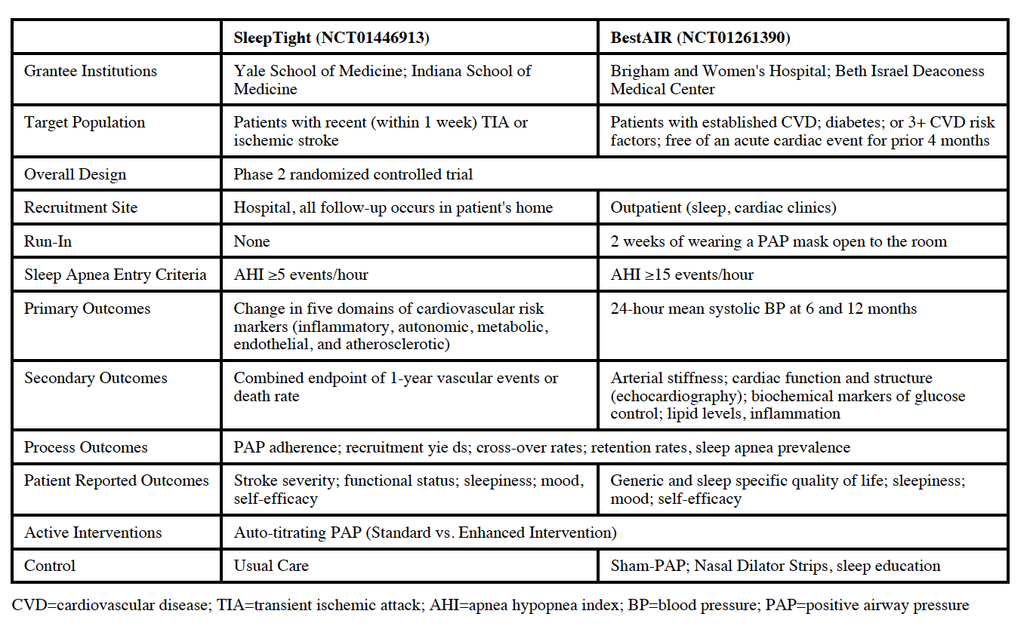
Notes:
Sleep tight: RCT to evaluate CPAP post TIA/CVA
Randomize to: CPAP vs CPAP w behavioral intervention+support
Outcome: change in parameters hypothesized to mediate stroke risk (surrogate outcomes)
BestAIR: measure 24h-BP and other surrogate/process measure outcomes. Mod-sev OSA, run-in w mask. RCT to: med therapy (CMT), CMT+sham CPAP, CMT+real CPAP, CMT+real CPAP&behavior

Slide 24
Why do phase 2 trials: Why surrogates? Why process measures?
Power ~ Sample size/$$$, Alpha, minimally important absolute effect size, info per data point (Continuous > HR > dichotomous), non-adherence/loss f/u
Need to estimate each of the above parameters
Surrogates: Chosen to show a larger effect size = smaller trial
  Validity depends on them correlating with the outcome of interest
Do NOT trust a positive clinical-outcome on a phase 2 trial powered to find a difference in a surrogate: increased error rates (Type 1 and 2)

Slide 25
Goals:
Understand that the disjunctive syllogism is the structure of a scientific argument
Know the limitations of a cross-sectional design as compared to cohort as compared to randomized trial viz-a-viz causal inference
Understand what a hazard ratio is and why they are so common in medical research
Know the determinants of a studies power.

